Slide 1
Data Base Technologies

Slide 2
Database Objects

Slide 3
Views
A View is a virtual table in the database whose
contents are defined by a query.
It can represent
- a subset of the data in a table(some of
the columns or rows from the base table)
- Data from multiple tables (joins)
Unlike table, view is not allocated any storage space
View doesn’t contain any data.It is a stored query.
View is stored in the data dictionary ,in the table called
USER_VIEWS

Slide 4
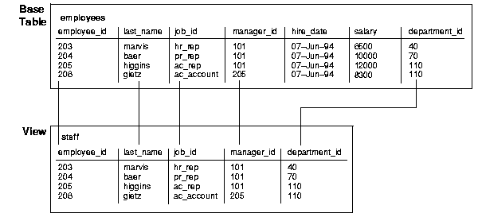

Slide 5
Importance of Views
Provide an additional level of table security by restricting
access to a predetermined set of rows or columns of a table
Hide data complexity
Simplify statements for the user
Present the data in a different perspective from that of the
base table
Isolate applications from changes in definitions of base tables
Save complex queries

Slide 6
Creating a View
CREATE [OR REPLACE][FORCE/NOFORCE]
VIEW view name AS query
[WITH CHECK OPTION]
[WITH READ ONLY];
OR REPLACE : Replaces the view if already exists.
FORCE: Creates the view (with compilation errors)
regardless of whether the view’s base table exists or the owner has privilege on them.
NOFORCE: Creates the view only if the base table exists and the owner has privilege on them (This is default).
WITH CHECK OPTION: Inserts & updates performed through the view will result in rows that the view can select.
WITH READ ONLY: No inserts,updates,deletes are performed on base table through view.

Slide 7
Guidelines for creating a view
The view’s default column names are same as the table’s column names.
New column names are explicitly listed in the CREATE VIEW clause.They should have one-to-one relationship with the column names listed in the select clause of the query.
New column names may be used where ever it is appropriate to change the column names appearing in the output of the view.

Slide 8
Guidelines for creating a view
GROUP BY clause can be used in the definition of a view.
Views may be joined or nested with other tables or views.
To create the view successfully one must have permissions to access all the tables referenced in the query.

Slide 9
Sequences
Sequences are database objects used to generate
unique integers
A sequence is an independent object and can be used
with any table that requires its output.
Sequences are generally used to automatically generate
Primary key values.

Slide 10
Syntax
CREATE SEQUENCE sequence_name
[START WITH integervalue
INCREMENT BY integervalue
MAXVALUE integervalue/NOMAXVALUE
MINVALUE integervalue/NOMINVALUE
CYCLE/NOCYCLE
CACHE integervalue/NOCACHE]

Slide 11
Sequences
INCREMENT BY Specify the interval between sequence
numbers. This integer value can be any positive or negative
integer, but it cannot be 0.
If this value is negative, then the sequence descends.
If the increment is positive, then the sequence ascends.
If you omit this clause, the interval defaults to 1.
START WITH Specify the first sequence number to be generated.
For ascending sequences, the default value is the minimum
value of the sequence. For descending sequences,the default
value is the maximum value of the sequence.

Slide 12
Sequences
MAXVALUE Specify the maximum value the sequence can generate. MAXVALUE must be equal to or greater than START WITH and must be greater than MINVALUE.
MINVALUE Specify the minimum value of the sequence. MINVALUE must be less than or equal to START WITH and must be less than MAXVALUE.

Slide 13
Sequences
CYCLE Specify CYCLE to indicate that the sequence continues to generate values after reaching either its maximum or minimum value.
After an ascending sequence reaches its maximum value, it generates its minimum value.
After a descending sequence reaches its minimum, it generates its maximum.
CACHE Specify how many values of the sequence Oracle preallocates and keeps in memory for faster access. The minimum value for this parameter is 2.

Slide 14
Synonyms
A synonym is an alias for any table, view, materialized view, sequence, procedure, function, or package.
Because a synonym is simply an alias, it requires no storage other than its definition in the data dictionary.

Slide 15
Synonyms
Mask the name and owner of an object
Provide location transparency for remote objects of a distributed database
Simplify SQL statements for database users
Enable restricted access

Slide 16
Synonyms
Private synonym is in the schema of a specific user who has control over its availability to others.
Every user in a database can access a public synonym
CREATE PUBLIC SYNONYM synonym_name FOR user.table_name.

Slide 17
Index
Indexes are database objects created on one or more columns of a table to speed SQL statement execution on the table.
Oracle index provides a faster access path to table data.
Oracle uses B-trees to store indexes.

Slide 18
Cluster
A cluster is a group of tables that share the same data blocks because they share common columns and are often used together.

Slide 19
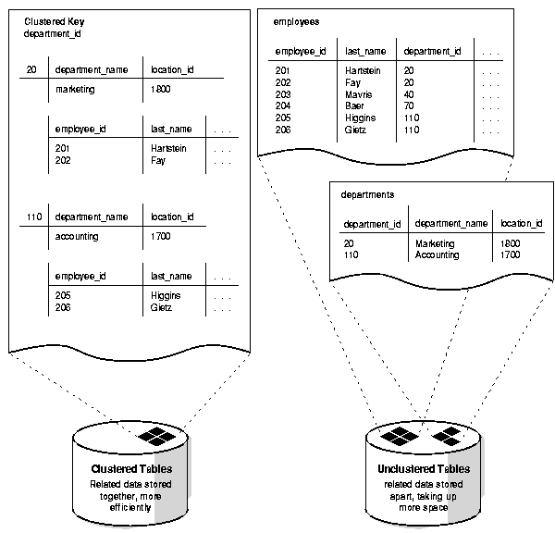
Index

Slide 20
Cluster
Disk space is reduced for joins of clustered tables.
Access time improves for joins of clustered tables.
In a cluster, a cluster key value is the value of the cluster key columns for a particular row.
Each cluster key value is stored only once each in the cluster and the cluster index, no matter how many rows of different tables contain the value. Therefore, less storage is required to store related table and index data in a cluster

Slide 21
Materialized Views (Snapshots)
It is a local copy of remote tables.
In distributed environments, materialized views are used to replicate data at distributed sites and synchronize updates done at several sites The materialized views as replicas provide local access to data that otherwise has to be accessed from remote sites.

Slide 22
Materialized Views (Snapshots)
CREATE MATERIALIZED VIEW view_name
REFRESH [FAST/COMPLETE/FORCE]
START WITH
AS query
create materialized view employee
refresh complete
start with sysdate next sysdate+7
with primary key
as select * from emp@REMOTE_CONNECT

Slide 23
Materialized Views (Snapshots)
create public database link REMOTE_CONNECT
connect to current_user
using ‘connect_string’
create public database link REMOTE_CONNECT
connect to scott identified by tiger
using ‘connect_string’

